Slide 1
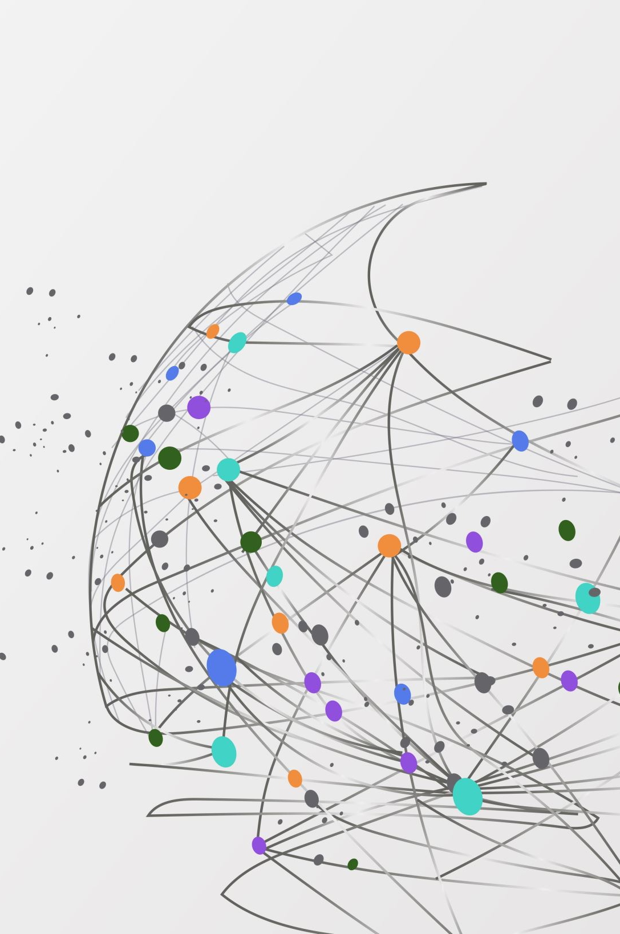

Scalable Image Classification in Manufacturing through Vision-Language Guided Ontology: a case study with FactoryNet
Team ADML
Mutahar & wILLIAM

Slide 2
Motivation:
Context driven
Scalable

Slide 3

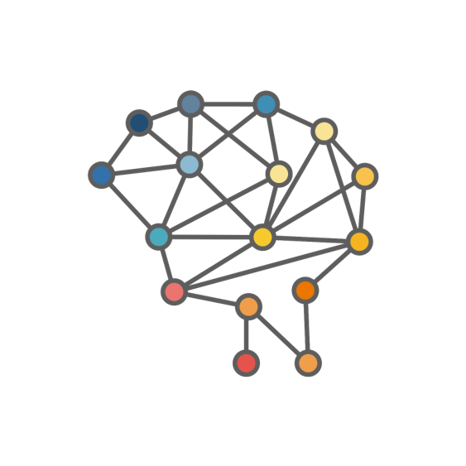
2
Language Space
1
Vision Space
3
Vision-Language Space
Domain
Driven
Data
Driven
Domain Ontology

Slide 4
Let’s explore FactoryNET…

Slide 5
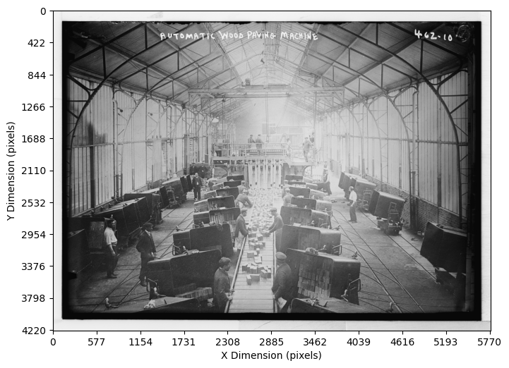
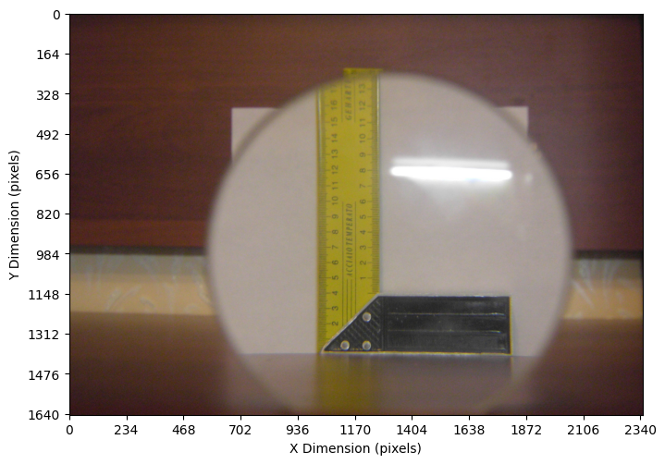
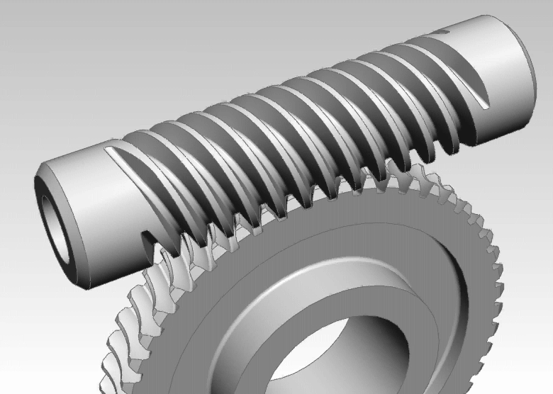
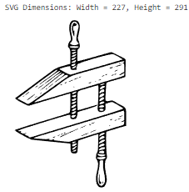
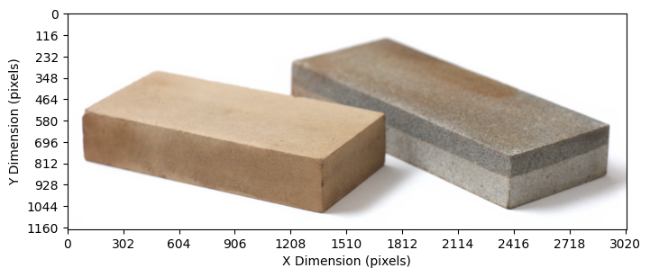
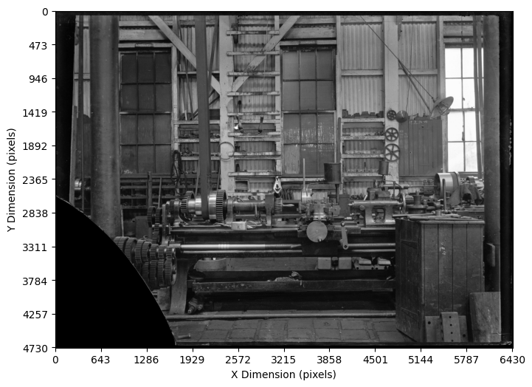
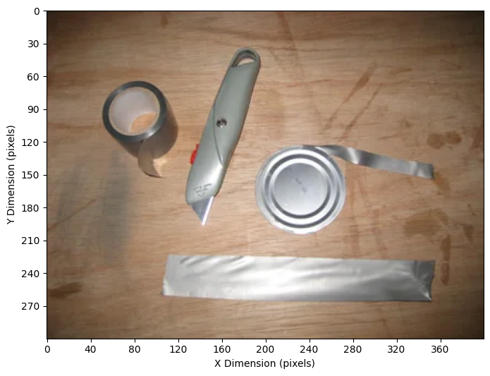
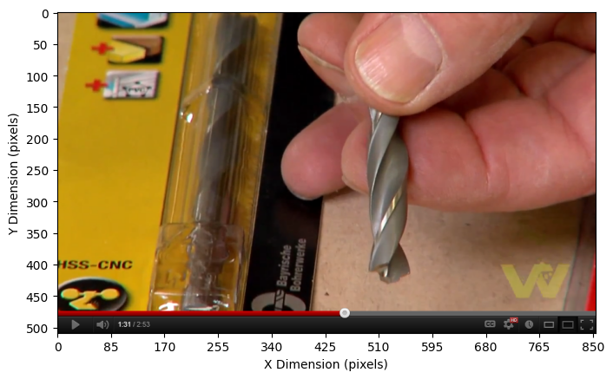
hackathon/data/1711587872914.jpg
hackathon/data/1711599794097.JPG
hackathon/data/1711615017696.gif
hackathon/data/1711604541829.svg
hackathon/data/1711579320996.jpeg
hackathon/data/1711575411757.png
hackathon/data/1711553022604.webp
hackathon/data/1711597242096.PNG

Slide 6
Key observations:
A set of real-world manufacturing contexts as images
Significant effort required to label and train multi-class models
Prevalent Noise
Unique & diverse but also related information within and across the images
Potential solution sequence:
Blind image clustering to find major categories + noise (level 1)
Clustering user labels to find unique categories (sub-levels)
Linking vision and language spaces to build hierarchy (ontology)
Zero-shot top-down vision-language detection (classification)

Slide 7
Why try transformers to explore FactoryNET vision space:
Best models available for vision-based applications
Several smaller variants that can be fine-tuned in self-supervised fashion (no labels!)
FactoryNET has real world context which can be detected by ImageNet or ObjectNet pre-trained architectures
Open-source options with Hugging Face hub

Slide 8
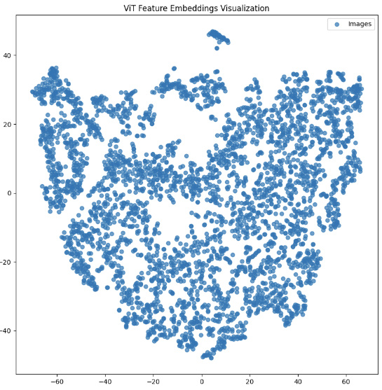
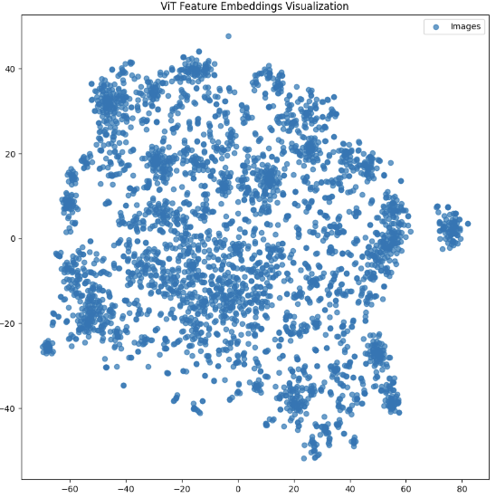
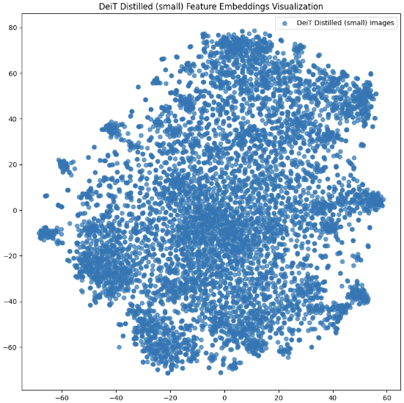
microsoft/beit-base-patch16-224
google/vit-base-patch16-224
facebook/deit-small-distilled-patch16-224
~50% dataset
~50% dataset
~100% dataset

Slide 9
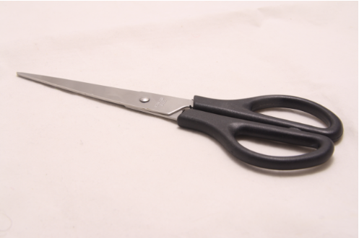
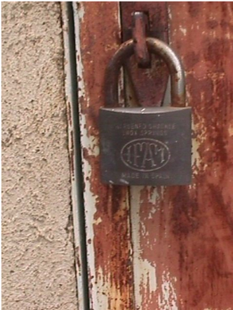
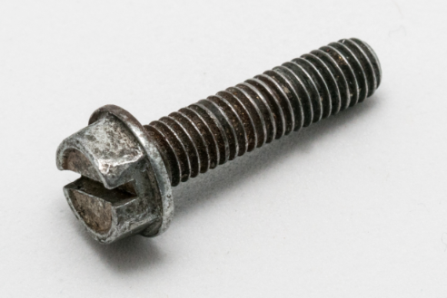
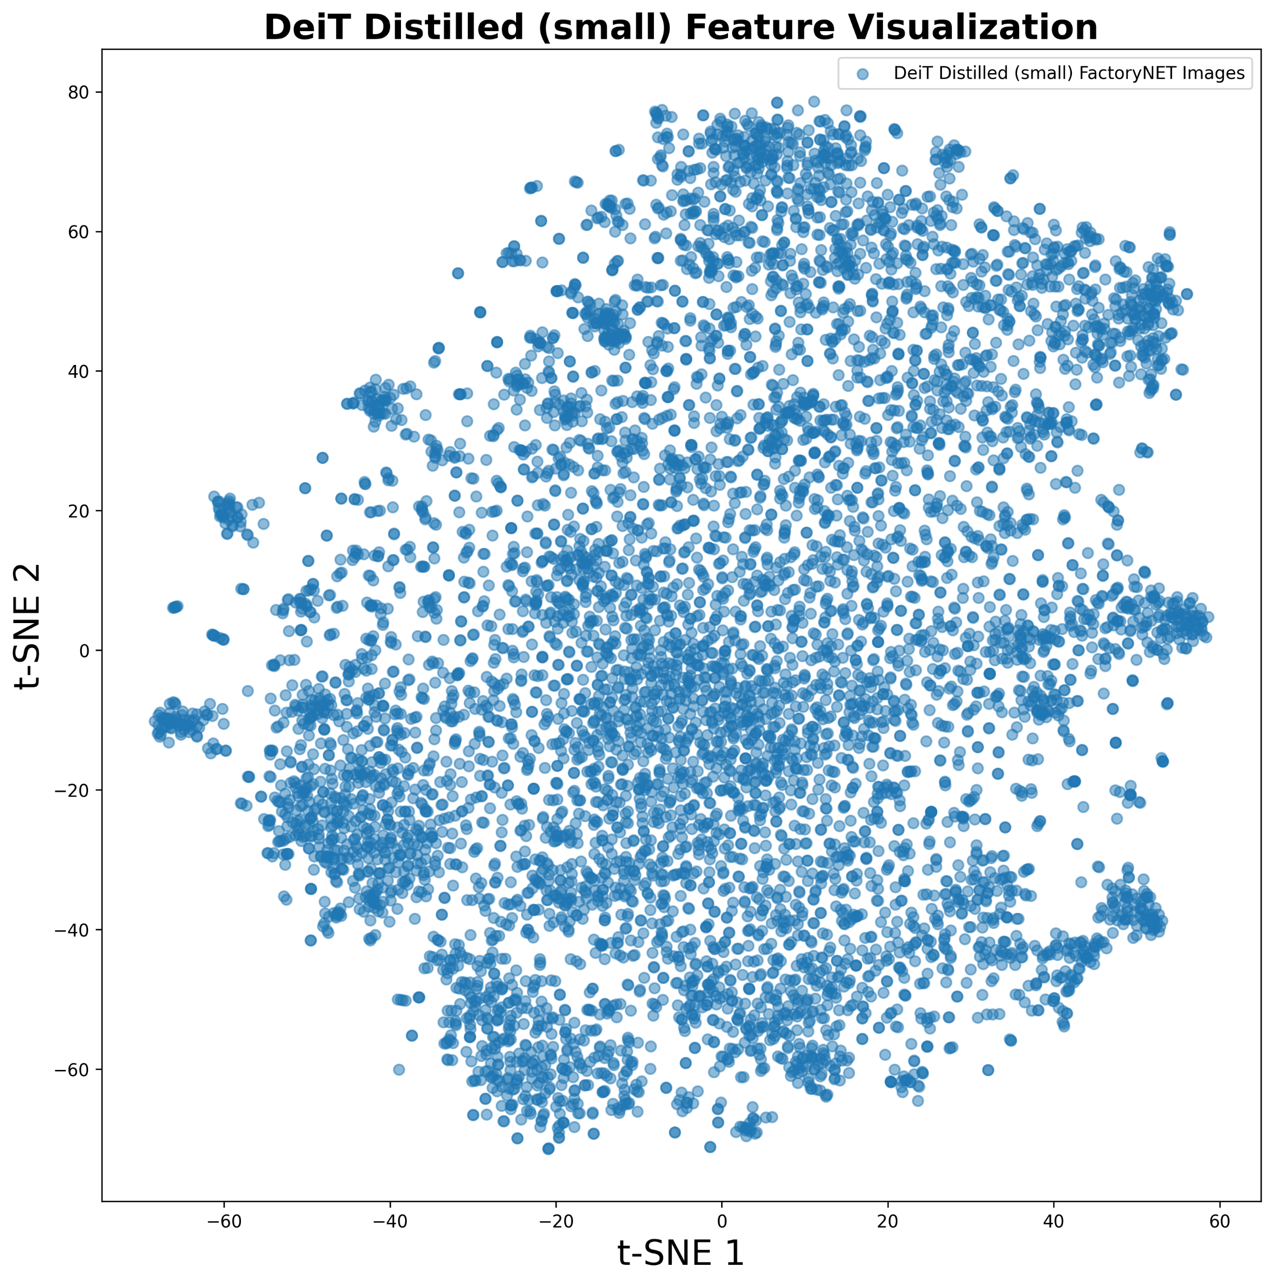
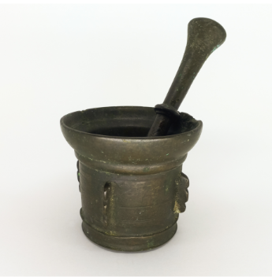
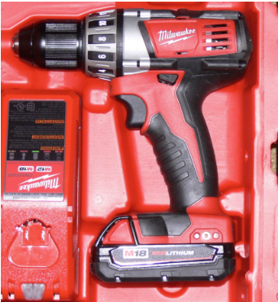
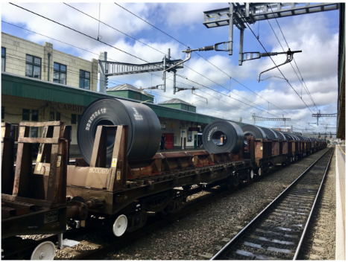
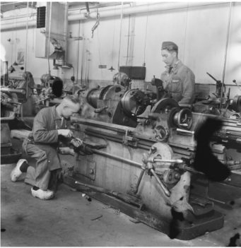
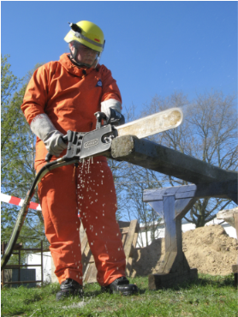
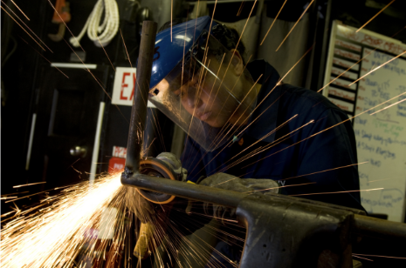
User labels in cluster:
- scissors, box cutter, wire cutter, shears, tool, hand tool, caliper…
User labels in cluster:
- lock, chain, looking carabiner, key, keys in lock, door, combination lock…
User labels in cluster:
- screw, hex bolt, nail, thread gauge, corkscrew, bolt, machine screw, wood screw, metal screw, nut and bolt, nails, square drive screw…
User labels in cluster:
- pot, mortars, pestles, mortars and pestles, stone…
User labels in cluster:
- drill, electric drill, power tool, hand drill, tool, cordless drills, corded power tools, hot glue gun, sanders, cutter…
User labels in cluster:
- train, train track, rail, railroad track, railing, rail car, train rail …
User labels in cluster:
- Stihl chainsaw, saw, hand saw, helmet, chain saw with timber, safety gear, hard hat, buck saw, ear protection, glove, goggles and helmet, wet saw…
User labels in cluster:
- lathe, metal lathe, bandsaw, person, welding mask, welder, printing press, pump drill, wood lathe, saw, drill, blacksmith, table saw, foundry, machine…
User labels in cluster:
- Welding tool, sparks, grinder, plasma cutter, welding, angle grinder, workpiece, safety equipment, heat torch, workpiece, face shield …

Slide 10
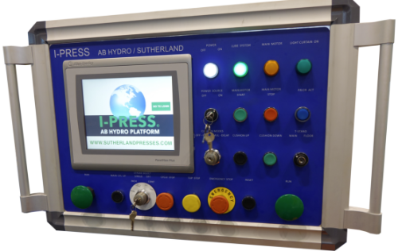
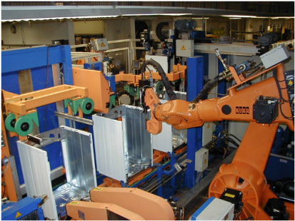
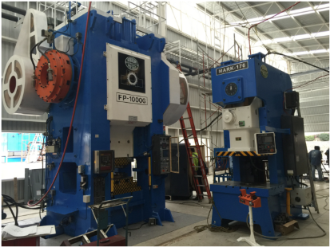
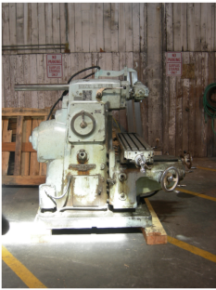
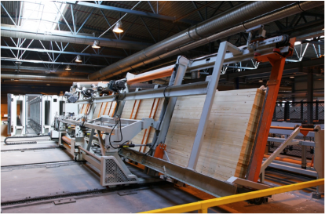
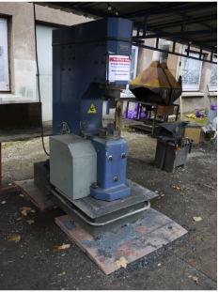
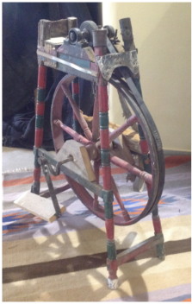

Slide 11
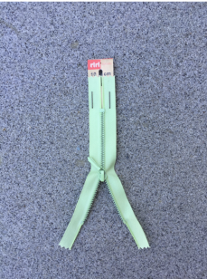
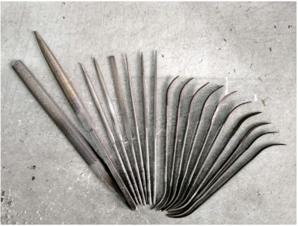
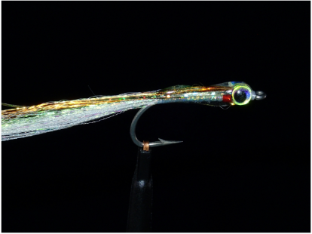
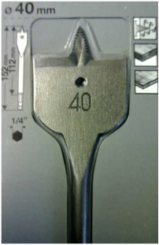
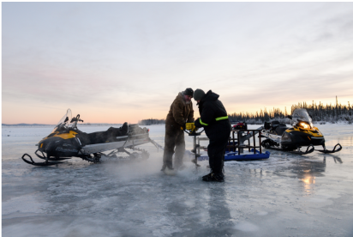
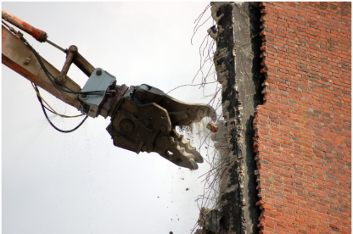

Slide 12
Insights from FactoryNET vision space:
Images with more real-world context, manufacturing related or not, can be easily separated into clusters
Images with more manufacturing-oriented context could be challenging to classify into standalone categories
Images that are relevant to manufacturing but have sparse presence in the current version could be difficult to categorize
Images exist that could be interpreted as noise since these have little to no manufacturing context

Slide 13
Clustering to identify levels of FactoryNET ontology:
Step to filter noise and keep track of images with manufacturing outliers
DBSCAN (Density-Based Spatial Clustering of Applications with Noise) for irregular clusters and noisy dataset
Finding best DBSCAN parameters (eps and min_samples) to find the clusters with k-nearest neighbors distance graph
Filtering the data to explore user label space

Slide 14
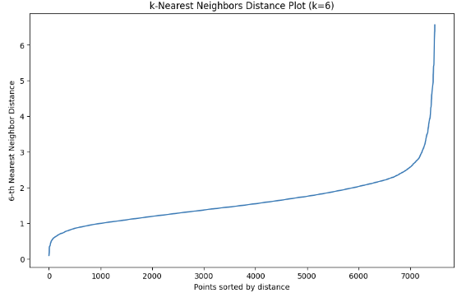
We keep “min_samples” search range less than, 10 assuming that visibly similar features are already places together
‘eps’ range for DBSCAN to explore

Slide 15
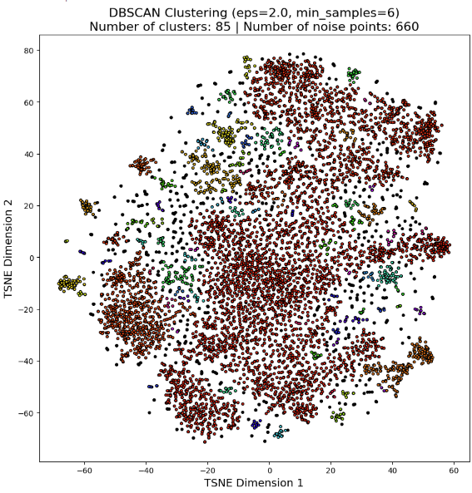
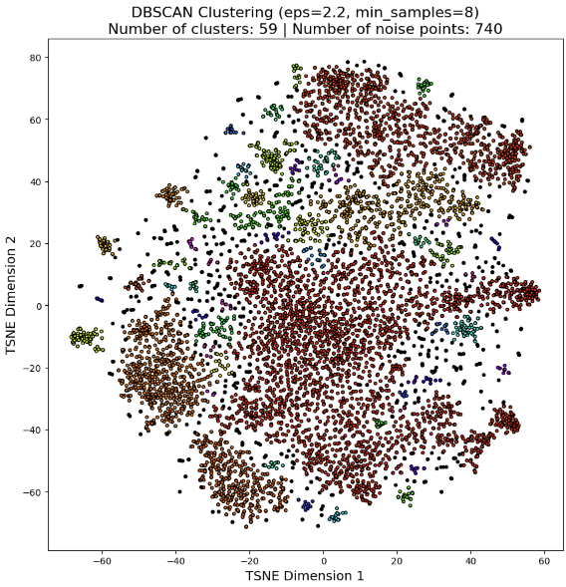
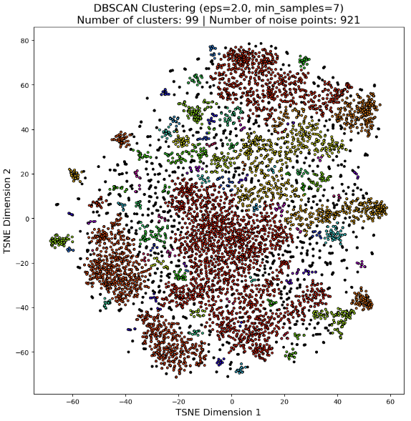
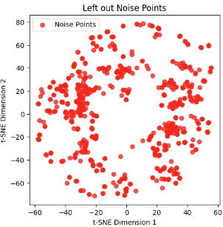
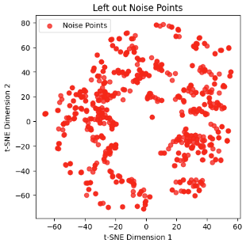
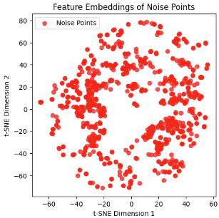
~8.8% dataset
~9.8% dataset
~12.3% dataset

Slide 16
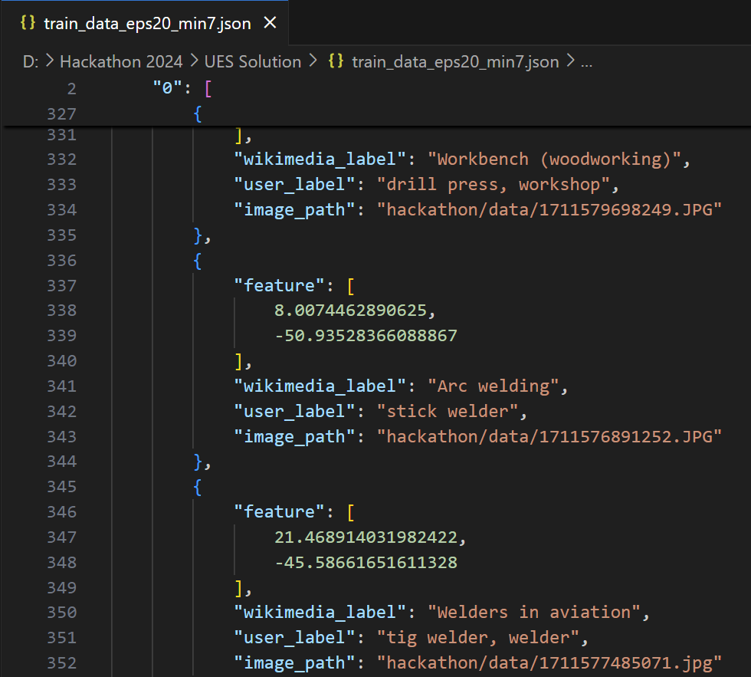
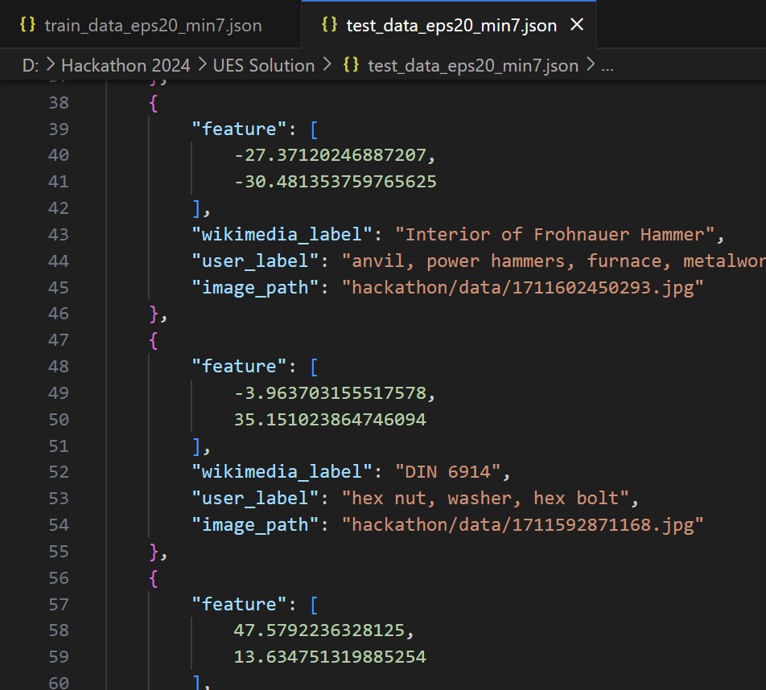

Slide 17
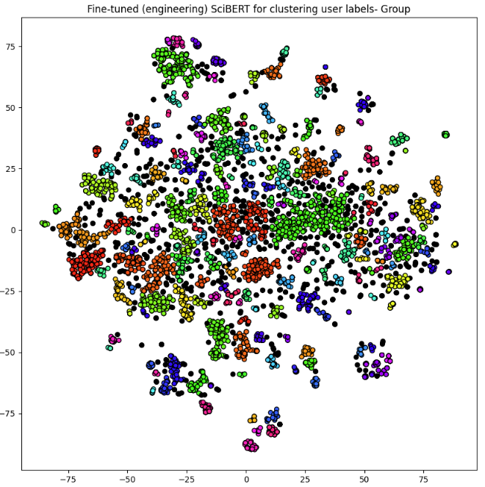
Number of noise points (non-colored): 958
User labels in cluster:
- manual tools…
User labels in cluster:
- Printing presses…
User labels in cluster:
- welder, welding equipment, welding gear…
User labels in cluster:
- Keys and locks…
User labels in cluster:
- Drilling rig, drilling equipment and infrastructure…
User labels in cluster:
- scissors…

Slide 18
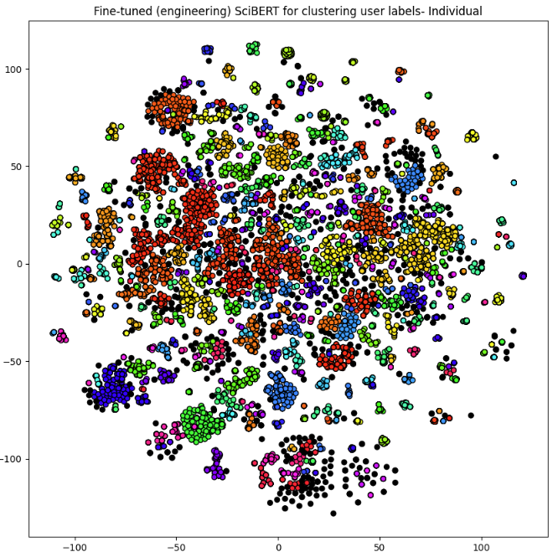
Number of noise points (non-colored): 792
Mostly circular saws …
Mostly lathes…
Mostly welding accessories …
Mostly hats…
Mostly windmills …
Mostly workbench & tools…
Mostly screwdrivers …
Mostly bulbs…

Slide 19
individual_user_labels.json
grouped_user_labels.json
{
"0": [
"label1",
"label2",
"label3"
],
"1": [
"label4",
"label5"
],
"2": [
"label6",
"label7",
"label8",
"label9"
],
...
}
individual_noise.json
{
"0": [
"label1, label2, label3",
"label4, label5"
],
"1": [
"label6, label7, label8",
"label9"
],
...
}
[
"noise_label1",
"noise_label2",
"noise_label3",
...
]
Develop upper levels
Test, refine, and mature
Develop middle levels

Slide 20
In terms of numbers so far:
Provided images: 7558
Test Images: ~921
Train Images:
Total User based labels: 15847
User labels in identified clusters: 12897

Slide 21
MASON Ontology
RESOURCES
OPERATIONS
ENTITIES
System
Technical
Material
Tool
Equipment
manufacturing
Non-manufacturing
Organization/
company
Human
Specific manufacturing operations
Measurement
Transport

Slide 22
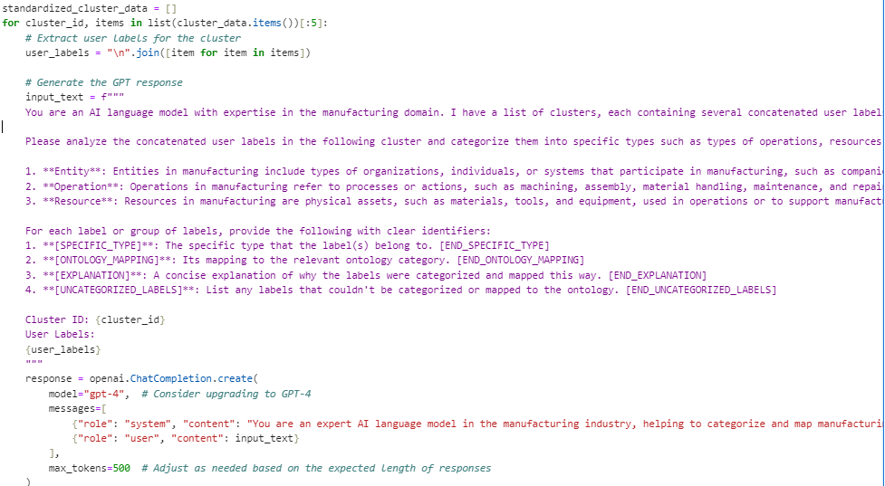
GPT Prompt for label synthesis

Slide 23
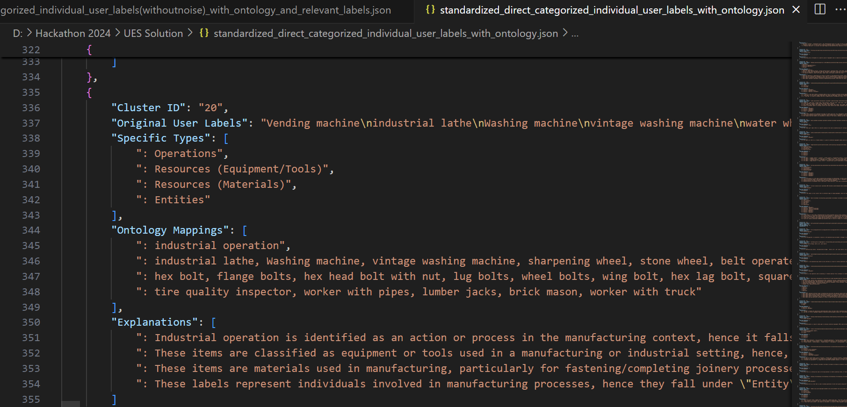
Detailed clusters with suggested subtypes and explanations

Slide 24
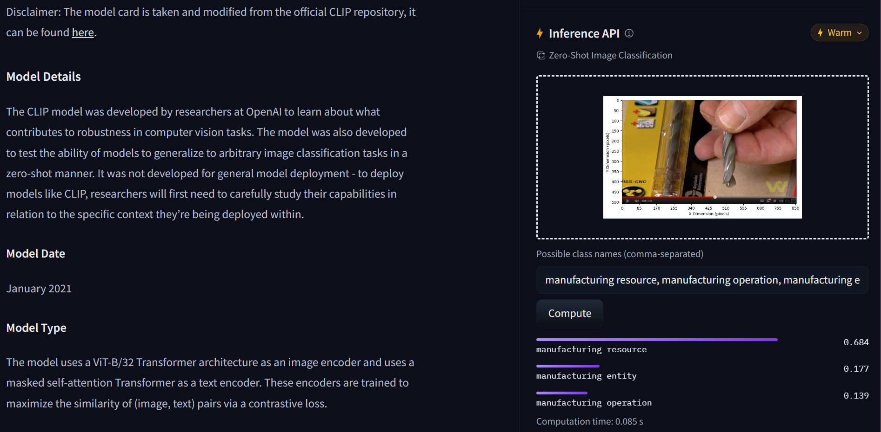
Vision language model for zero-shot classification

Slide 25

Evaluate our results on test image split for level 1: classification_results.csv

Slide 26
Resources to enhance our work:
Vision-based Train/Test split: (test_data_eps20_min7.json, train_data_eps20_min7.json)
Domain language-based clustering [Group]: (grouped_user_labels.json, grouped_noise.json)
Domain language-based clustering [Individual]: (individual_user_labels.json, individual_noise.json)
GPT 4.0 categorized user labels with manufacturing-based explanations: (standardized_direct_categorized_individual_user_labels_with_ontology.json)
GPT 4.0 categorized user labels: (GPT categorized user labels with manufacturing-based explanations: (standardized_direct_categorized_individual_user_labels_with_ontology.json)
Working notebook for:
FactoryNET EDA
Vision Space Exploration
Language Space Exploration
Synthesizing FactoryNET labels with GPT API and prompts
CLIP-based zero-shot classification (level 1)

Slide 27
Thanks for your attention
Q/A

